Slide 1
The Special Education Department
March 1, 2016
Curriculum Night

Slide 2
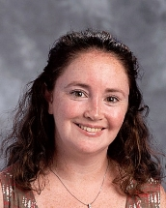
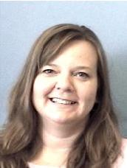
Leaders of the Department
Kathleen DeLisi
Team Leader Liaison
Corinne Nye
Department Head

Slide 3
Special Education Programs at FHS
Learning Center
Phoenix Program
Applied Level Classes
Inclusion Classes

Slide 4
Glimpse at the Learning Center
The Learning Program at Framingham High School is a program designed for students on the Autism Spectrum. Most of the students have severe disabilities. This program works on life and functional skills.
Lead Teacher is Natalya Mains
These students will not take the MCAS and will graduate with a Certificate of Completion.

Slide 5
Learning Center Curriculum
Functional Math
Functional English
Functional History
Functional Science
Functional Life Skills
Functional Health
Functional Reading
Integrated Electives
These courses are for students in the Learning Center Program only!

Slide 6
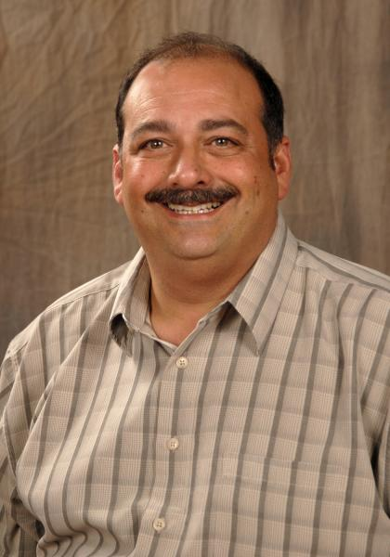
Leader of the Phoenix Department
Andrew Benedetti
Phoenix Program Chair
Phoenix Staff
Two Behavior Specialists
Two Social Workers
Four Academic Teachers
Two Teaching Assistants

Slide 7
Phoenix Department
Students of the Phoenix program present with a variety of emotional and social impairments. The program modifies the syllabus, which is representative of the general education curriculum adapting for pace, depth, and workload. Behavior management strategies are strength-based that strive to focus on the students' abilities and to teach the skills necessary for academic success and the development of positive, reciprocal relationships.

Slide 8
Phoenix Course Selection
Phoenix History:
Phoenix Modern World History
Phoenix US History I
Phoenix US History II
Phoenix Science:
Phoenix Biology
Phoenix Biology II
Phoenix Electives:
Phoenix Health
Phoenix Freshmen Seminar
Phoenix Life Skills
Phoenix Film Study
Phoenix Human Diseases
The 1960’s Through Music
20th Century Art
Phoenix Career Development Program
Phoenix English:
Phoenix English 9
Phoenix English 10
Phoenix English 11-12
Phoenix Math:
Phoenix Algebra I
Phoenix Geometry
Phoenix Algebra II
These courses are for students in the Phoenix Program only!

Slide 9
Phoenix Program Outlook
Course Sequence
Grade 9 | Grade 10 | Grade 11 | Grade 12
Phoenix English 9 Phoenix Algebra 1 Phoenix Modern World Phoenix Biology Part 1 Phoenix Freshman Seminar Phoenix Health Phoenix Film Study Phoenix Human Diseases The 1960’s Through Music 20th Century Art | Phoenix English 10 Phoenix Geometry Phoenix US History 1 Phoenix Biology Part 2 Phoenix Film Study Phoenix Human Diseases The 1960’s Through Music 20th Century Art | Phoenix English 11 Phoenix Algebra 2 Phoenix US History II Phoenix Film Study Phoenix Human Diseases The 1960’s Through Music 20th Century Art | Phoenix English 12 Phoenix Film Study Phoenix Human Diseases The 1960’s Through Music 20th Century Art Phoenix Career Development

Slide 10
The Applied Program
The Special Education Department provides specially designed instruction to meet the unique needs of students with disabilities. Students eligible for Special Education services have Individualized Educational Programs that can include both Special Education and Regular Education courses. The primary goal of the department is to support and encourage maximum student involvement in regular education courses to the extent appropriate. Students who have a specific learning disability in a specific content area will be eligible to take an academic course at the Applied Level.

Slide 11
Applied Level Classes
English Courses:
Applied English I
Applied English II
Applied American Literature
Applied World Literature
Math Courses:
Applied Algebra I
Applied Geometry
Applied Algebra II
Applied Consumer Math
History Classes:
Applied Modern World
Applied US History 1
Science Classes:
Applied Biology Part 1
Applied Biology Part 2
Reading:
Structures of Reading

Slide 12
Special Education Classes Not Academic Specific
Grade 9 Academic Support (5x per cycle)
Study Skills/Strategies (2x or 4x per cycle)
High School to the Future Part I (Second Semester of Junior Year)
High School to the Future Part II (First Semester of Senior Year)

Slide 13
Special Education Courses Outlook
Course Sequence
Grade 9 | Grade 10 | Grade 11 | Grade 12
Applied English 1 Applied Algebra 1 Applied Modern World Applied Biology Part 1 Grade 9 Academic Support | Applied English 2 Applied Geometry Applied US History 1 Applied Biology Part 2 Study Strategies | Applied American Literature Applied Algebra 2 Study Strategies HS to the Future Part 1 | Applied World Literature Applied Consumer Math Study Strategies HS to the Future Part 2

Slide 14
Inclusion Courses
In collaboration with the General Education Classes, the Special Education Department offers courses with both a general educator and a special educator. They are:
Algebra 1
Geometry
Algebra II
English 1
English 2
American Literature
World Literature
These classes are at the CP2 level.

Slide 15
Questions?
Email:
cnye@framingham.k12.ma.us (Department Chair)
kdelisi@framingham.k12.ma.us (Team Leader Liaison)

